Slide 1
Final project of JavaSchool
Deutsche Bank Graduate Program
Sakhno Ivan
St. Petersburg, 2018

Slide 2


About project
Crawler
ML Module
(Predictor)
Mongo DB
Frontend
WebApi
(Rest)

Slide 3




Technology Stack

Slide 4


Technology Stack

Slide 5
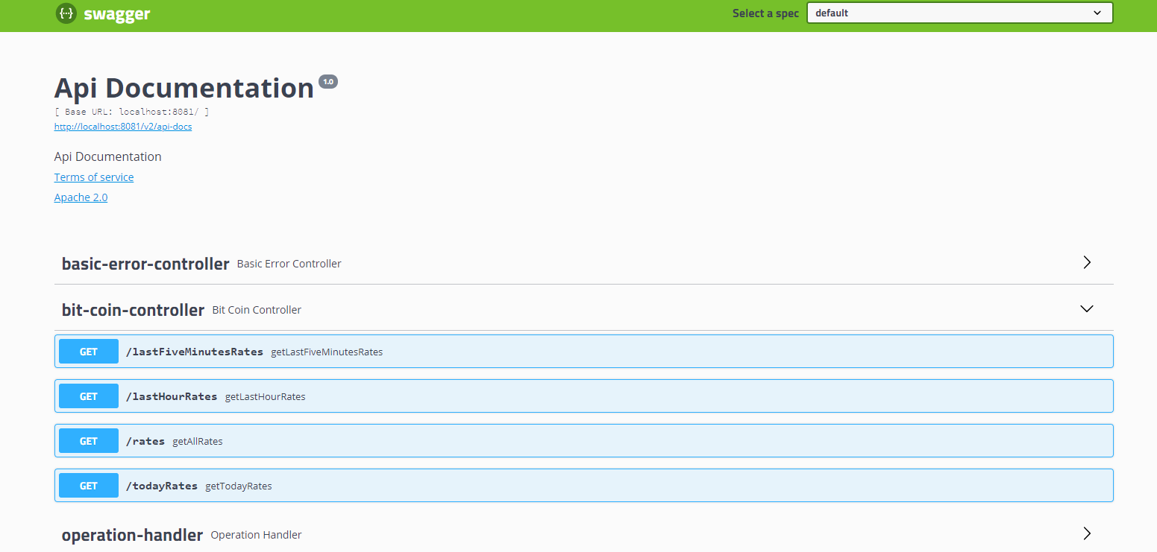
Swagger

Slide 6
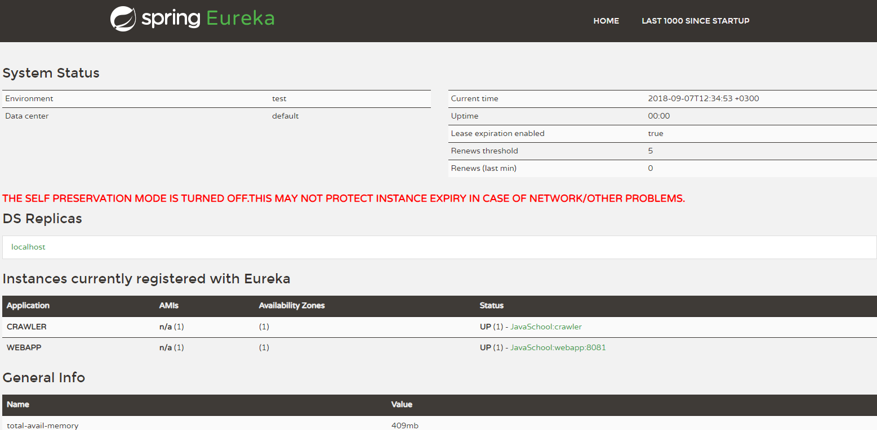
Eureka

Slide 7
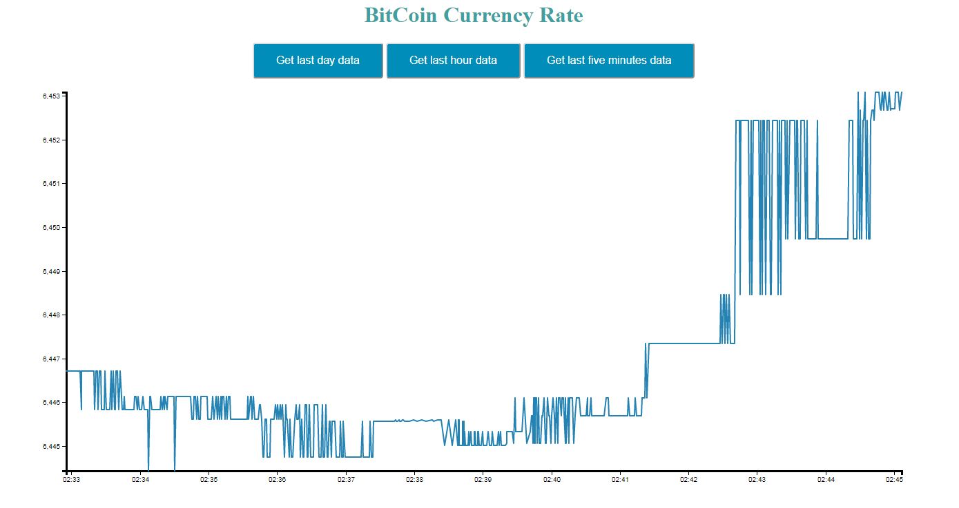
Example of work

Slide 8
Q&A

